Slide 1
Situational Awareness Power App v1
Terms of Reference

Slide 2
01
What is it
Overview of the product and why
Concept
Why is it necessary
Use the location, and time of day/day of week, of a frontline officer to produce highly personised information feeds that:
Display any tasks that have been assigned to them that are nearby
Display any events that have occurred in the area that may influence the decision making of the officer
Display, and allow actioning of, requests for proactive policing in the area, such as:
ASB Hot Spots
Wanted Offenders
Victim Welfare Visits
Government support, and funding, again for hot spots policing
Hot spots policing seen as tool in serious violence reduction
Supplements the knowledge of officers with limited time in service, which is a significantly increasing problem
Is a contracted commitment for WMP and Northumbria
Core APD CAB TOR | Feb 2021

Slide 3
02
Scope of v1
What do we want to do
Functional Scope
Non-functional Scope / Assumptions
Produce an "I'm at this location, what are my tasks?" service that will be used by the PowerApp
Produce an "I'm at this location, what has happened nearby recently?" service that will be used by the PowerApp
Produce a mobile focused (phone and tablet) PowerApp that will leverage these Services via a connector
Product an office focused PowerApp to allow the creation and maintenance of proactive policing demands e.g. ASB Hotpost
Allow display and actioning of Proactive Policing Demands from the PowerApp
Have Power BI report on and analyse proactive policing demands
Build demonstrator, with reusable elements (services, connector and UI) when later creating production
Knowledge transfer around the architecture around Connectors
Knowledge transfer around building PowerApps
Use of the National POLE Standards
Connector to be architected to be agnostic of any specific RMS. Future RMS support will be needed for Niche
No requirement for any Connect development to deliver
Connect access should be by POLE and POLEflow APIs
Data relating to Proactive Policing Demands to be held in external datastore e.g. MS-SQL Server, Lists, SharePoint, Dataverse. etc.
Ensure accessibility standards followed
Core APD CAB TOR | Feb 2021

Slide 4
03
Resources
Who will do it
In House
External
Bruce Clark product owner
Adam Middleton & Mark Greaves for architecture
Get Technossus to quote including time for:
Knowledge transfer especially on architecture
Solution architecture documentation
Creating extensible reusable UI components
What is ‘good practice’ in areas such as accessibility, security, audit, etc within power platform
What is ‘good practice’ in terms of separation of interfaces, services and connectors
Link this to the project to the Mobile ID (OIFR) one where they are building a common gateway.
Core APD CAB TOR | Feb 2021

Slide 5
04
Managing
Ensuring success
Dependencies
Governance
People:
POLE data team
Connect DevOps team
Technology:
An Azure environment
A Connect cloud environment
Take part in design reviews
Have Microsoft SME provide input
Take part in some development rituals
Engagement with users - esp WMP & Northumbria & Met
We will have further comfort in ?? weeks as we got more visibility of designs, processes and outputs.
Core APD CAB TOR | Feb 2021

Slide 6
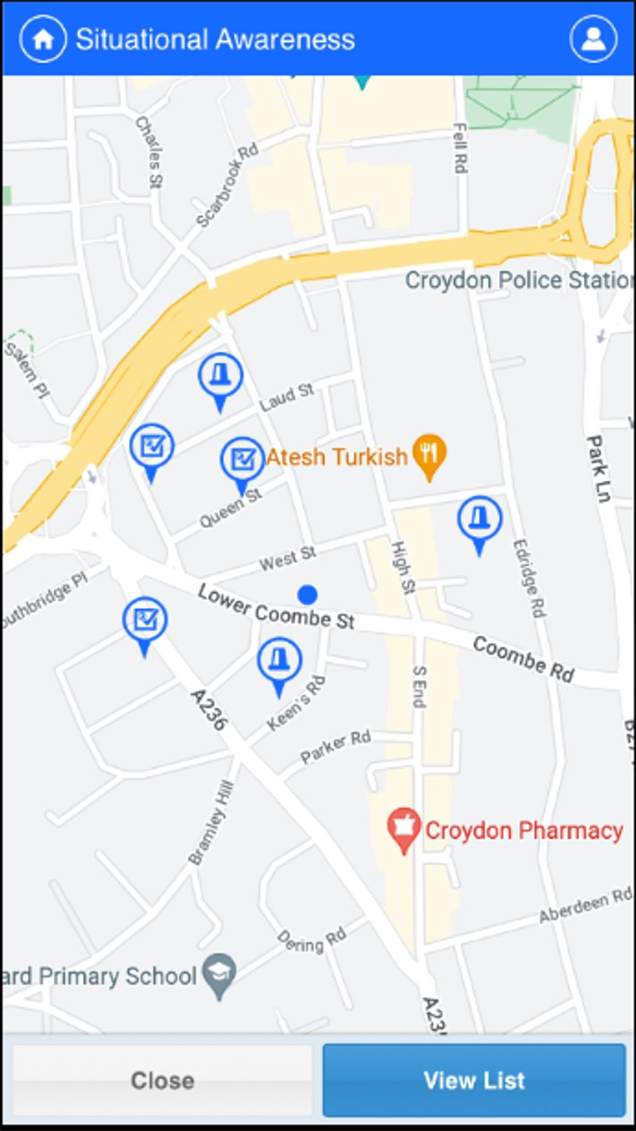
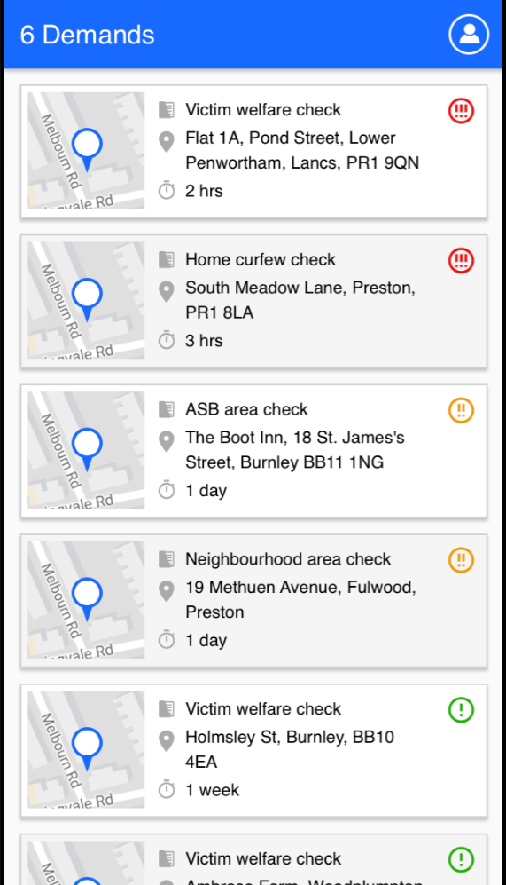
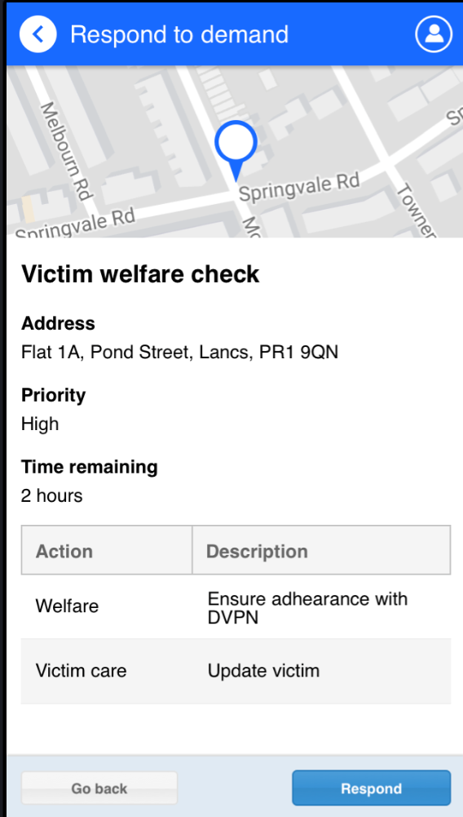
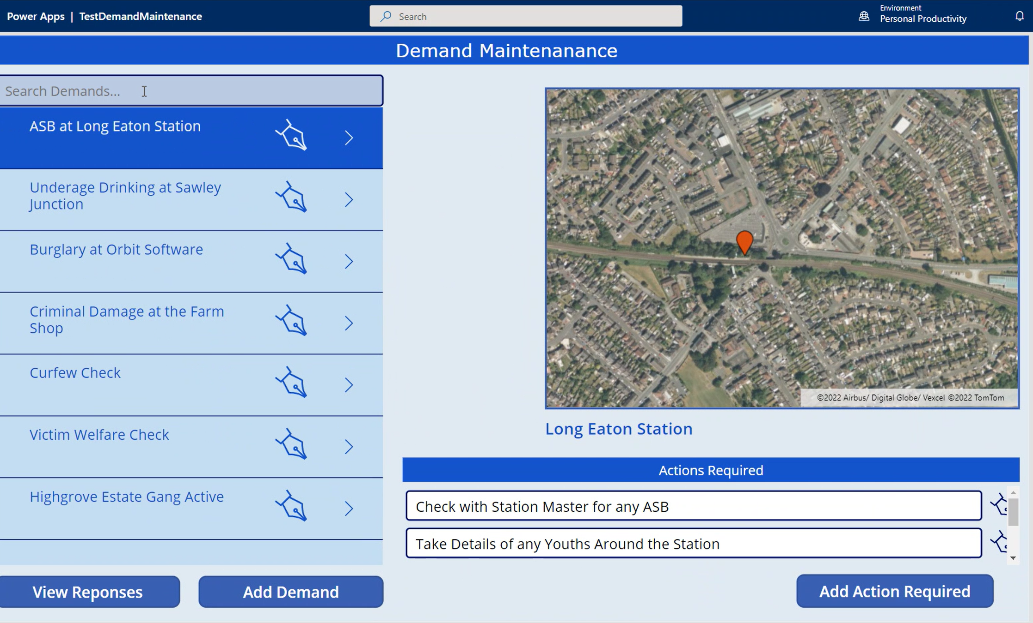
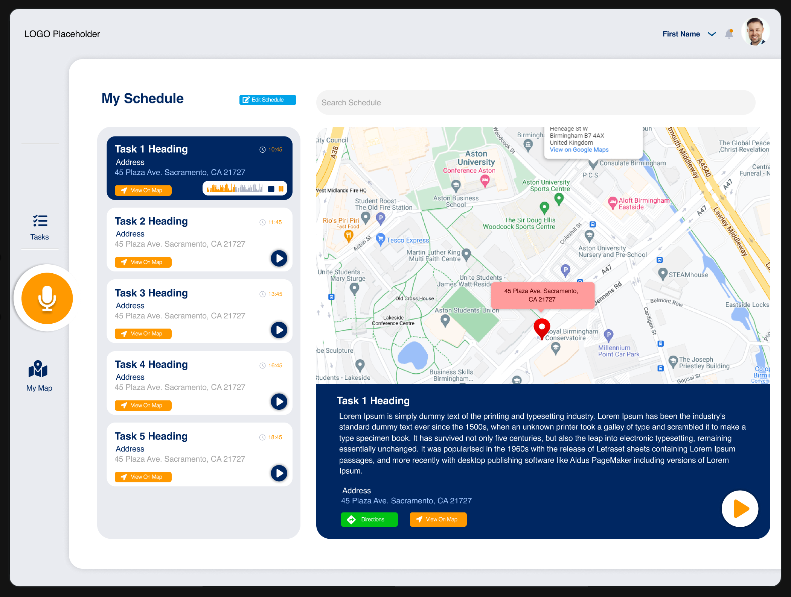
05
Visualisation
What it looks like
Original Concept
Power App Mockup
Future State
Core APD CAB TOR | Feb 2021

